Slide 1
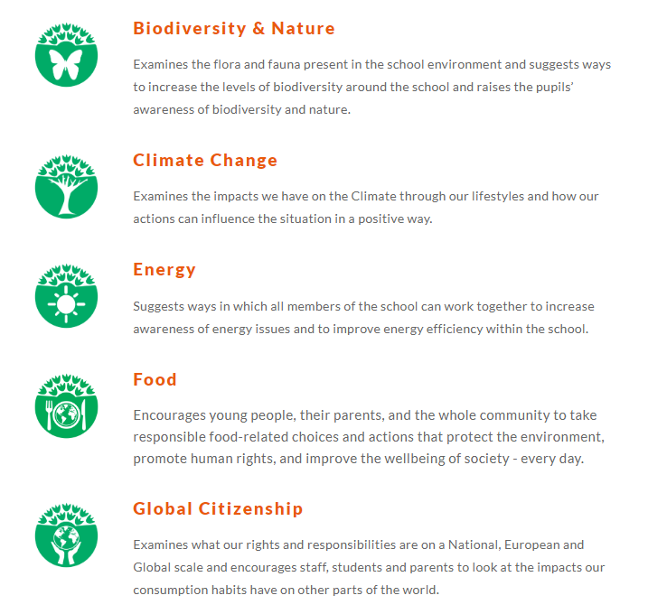
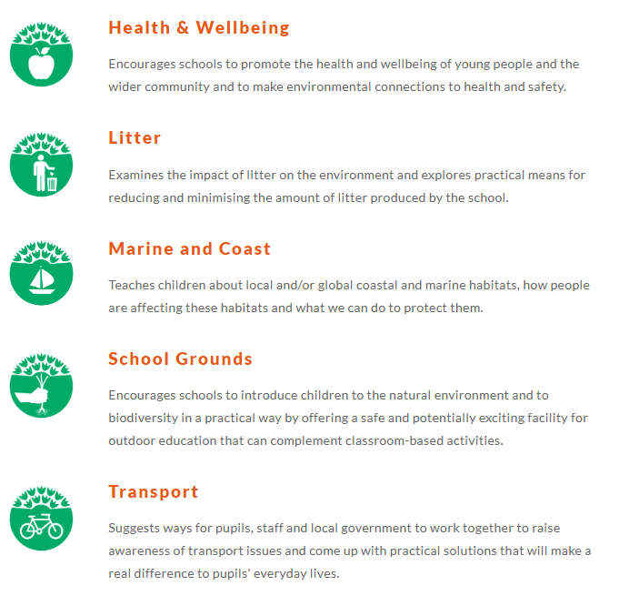
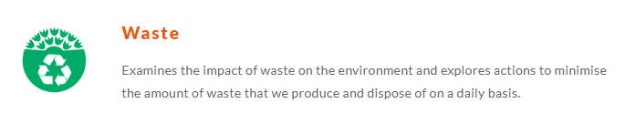

Slide 2
How eco friendly are you?
Ways to be eco friendly
https://www.youtube.com/watch?v=P6jG2kJoW2c

Slide 3
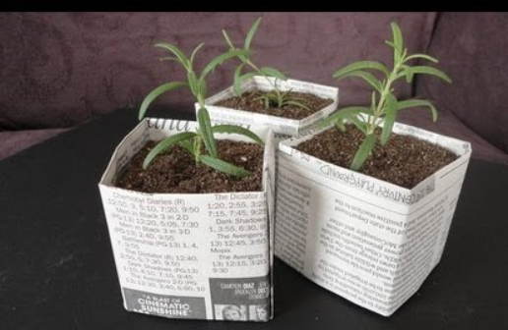
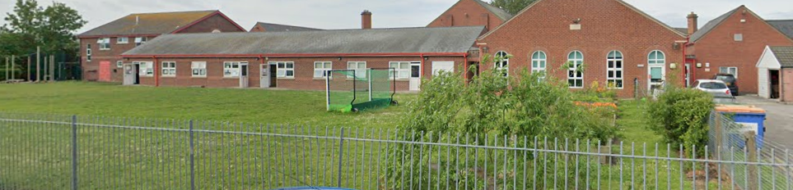
YEAR 1
School Grounds
how can we improve ?– growing plants

Slide 4
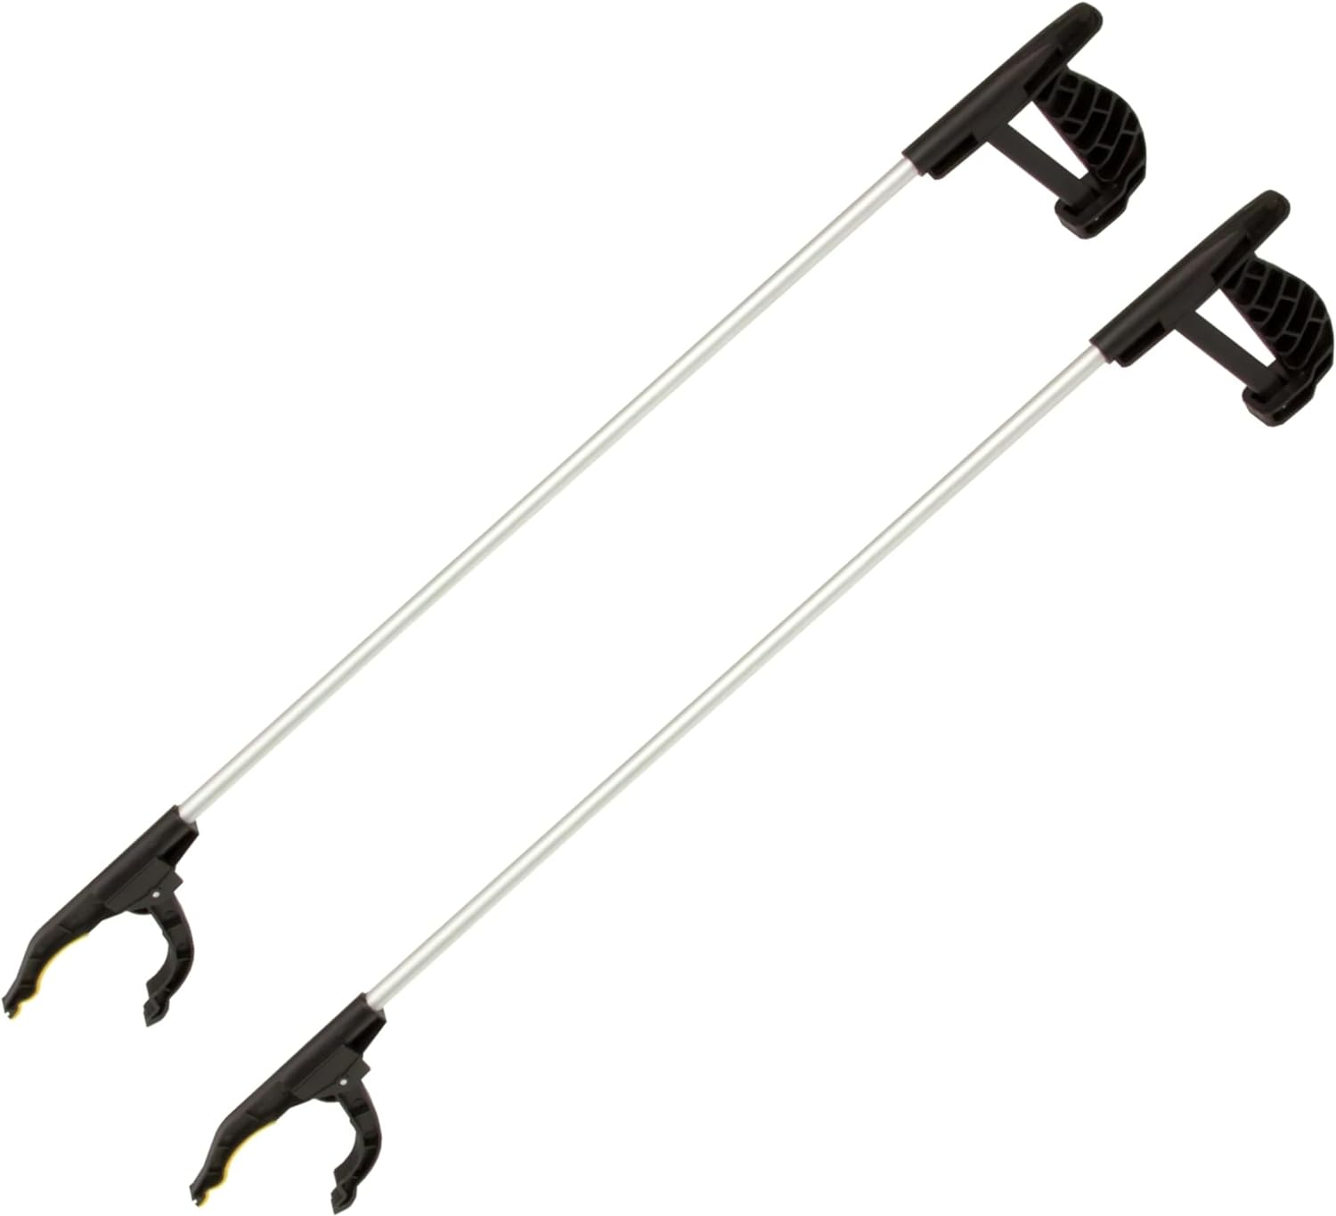
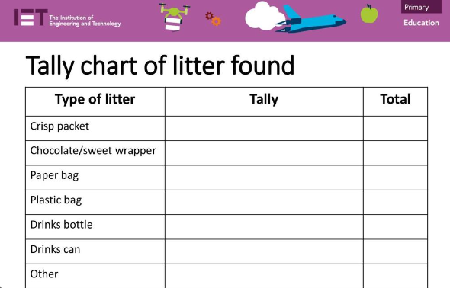
YEAR 2
Litter

Slide 5

YEAR 3
Energy
Look at ways to save energy
Create signs for around school

Slide 6
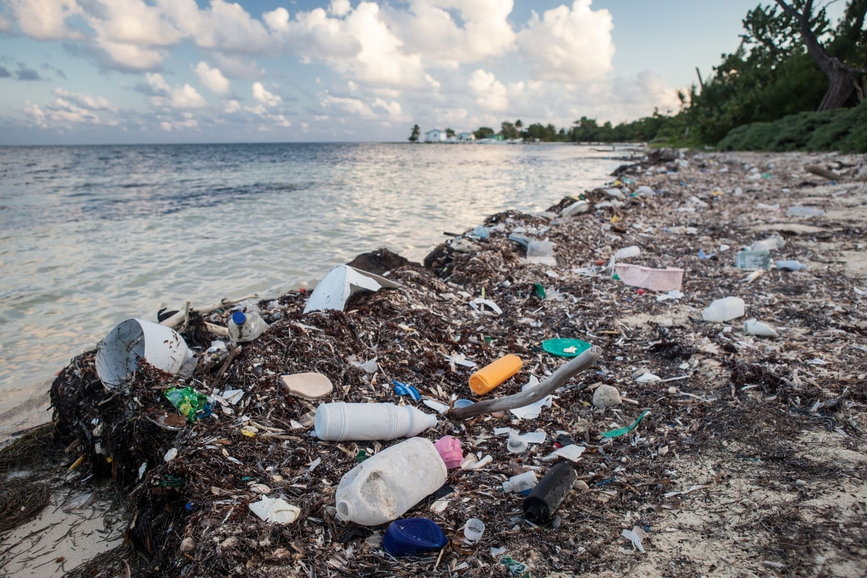
YEAR 4
Marine
Effects of plastic pollution on marine life

Slide 7
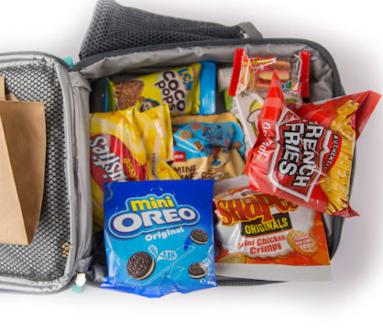
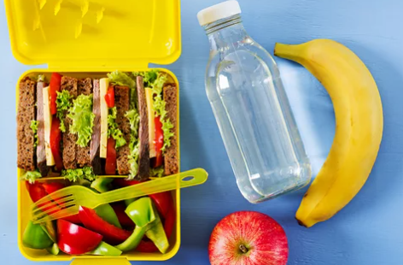
YEAR 5
Waste
Waste collectors
Weigh and log plastic waste from packed lunches

Slide 9
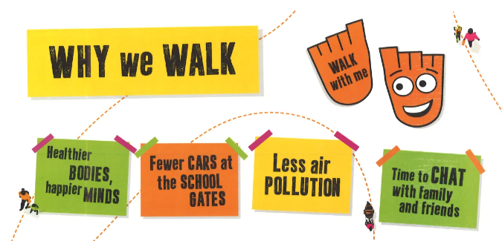
WALK TO SCHOOL
Your class teacher will log this – can you beat your class number next Monday?

Slide 10
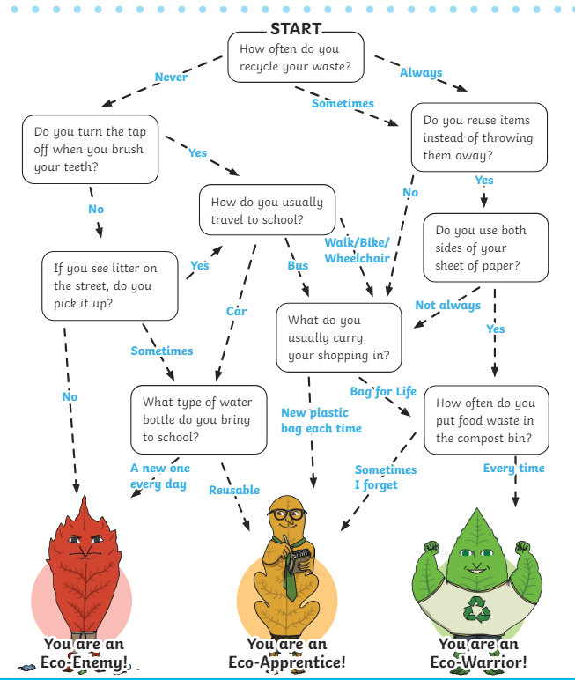
How eco-friendly are you?

Slide 11
https://www.youtube.com/watch?v=0Puv0Pss33M

